Slide 1



Automatic Concussion Evaluation (A.C.E.)
John Tarasidis - EE
Brian Sang - CompE
Sean Kim - EE
Michael Lee - CompE
Jonathan Park - EE
Dale Shober - BME
Thank you to our sponsors:

Slide 2
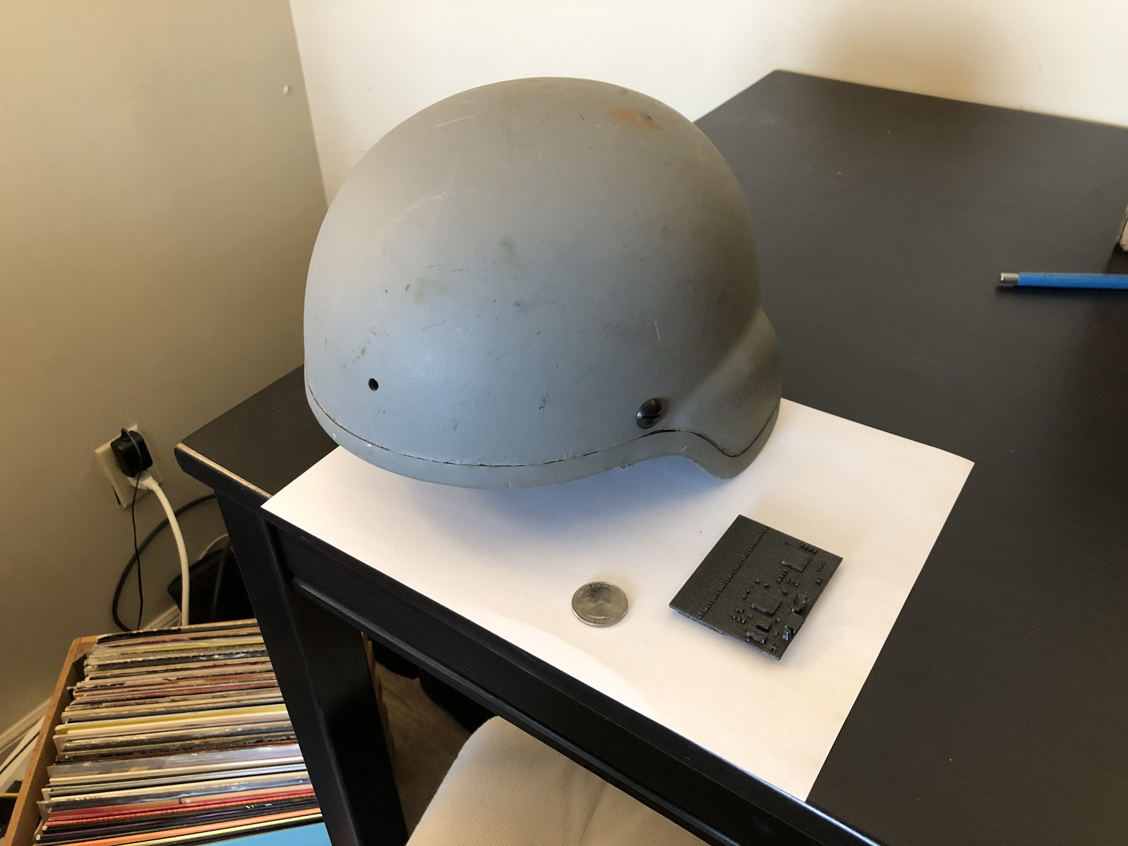
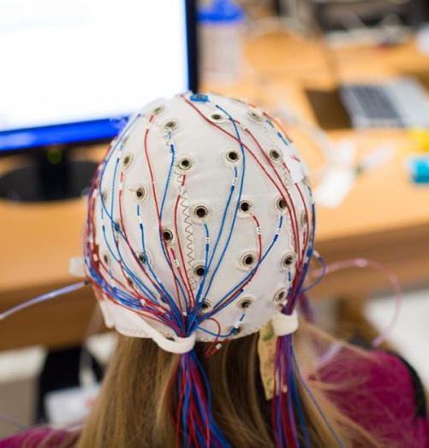
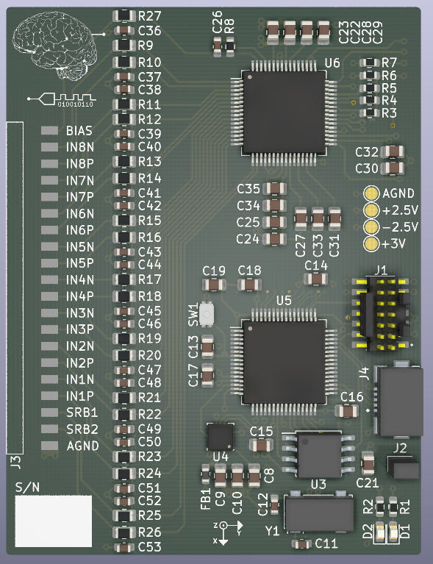
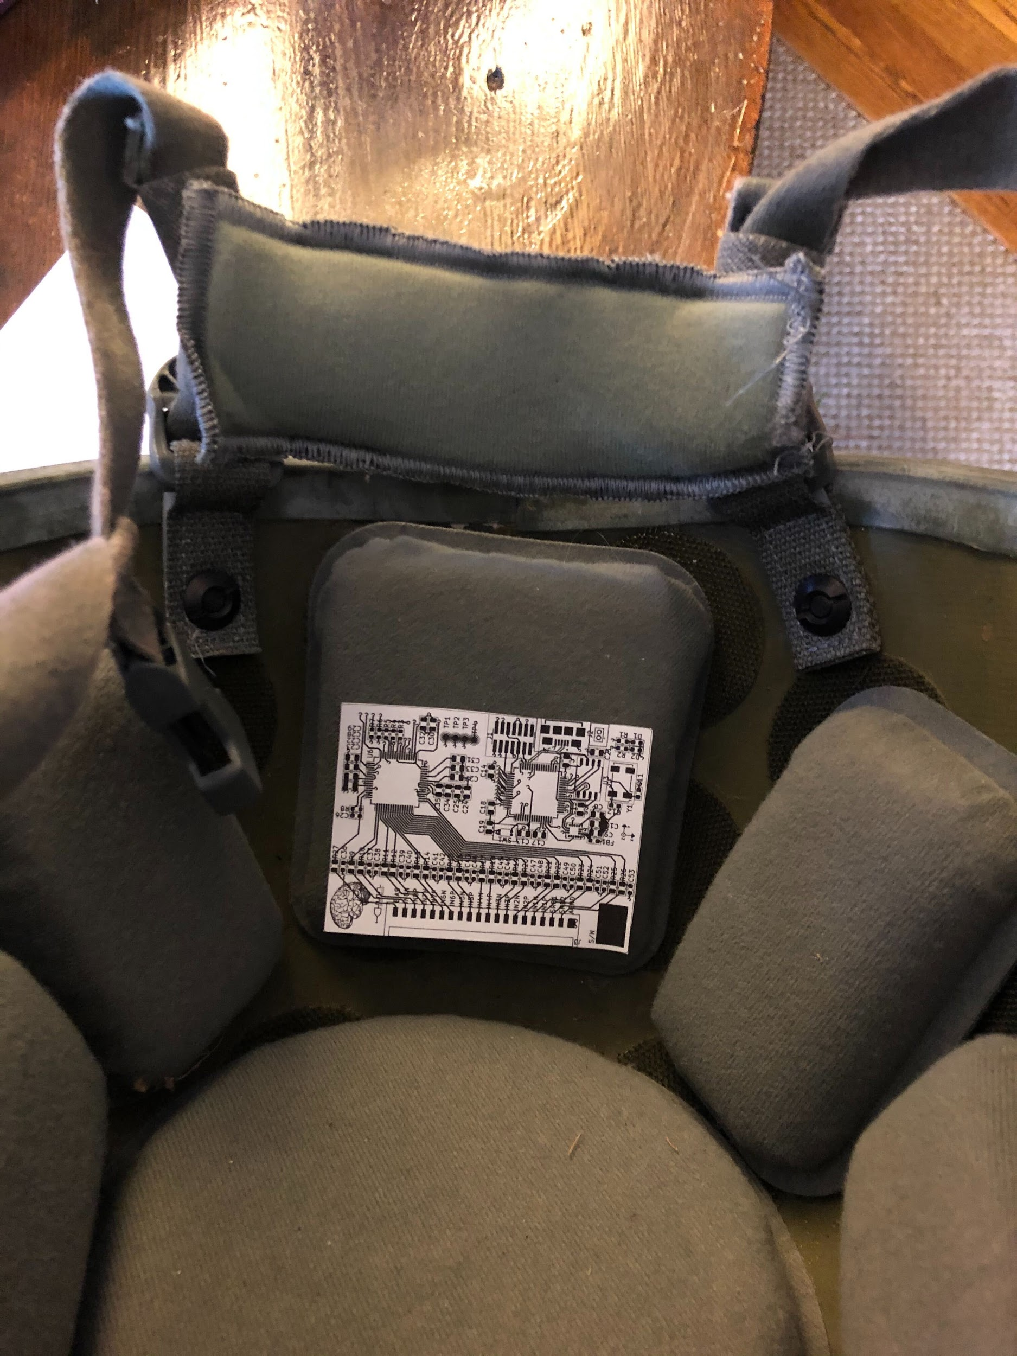
Our Solution
Only 2”x2.5”
Example of a clinical EEG
Rendering of the ACE mini EEG
Mockup of the ACE mini EEG inside of a Military Helmet
10 devices currently being manufactured!
Notes:
I think we should simply put a render of the board and a photo of the 3D printed version relative to the actual helmet size

Slide 3
Implications – The New Standard of Care
New Care Sequence
Reduces screening uncertainty from 30-60% down to 10%
Currently working with Ft. Benning through NSIN to test prototypes
Proper care of mTBI can reduce long term symptoms and the prevalence of comorbidities such as PTSD or CTE
Automatic Concussion Evaluator
Neuroimaging (Potentially Optional)
Treatment
Notes:
New Standard of Care
Changing the care sequence at the initial stages (unique) - FAST
Trying to be Proactive rather than reactive
(TIMELINE IS KEY)
Don’t want to wait for symptoms to onset
Much more accuracy at the screening stage (quantitative rather than qualitative)
Rather than questionnaires, putting data into the mix to diagnose early
PTSD symptoms similar to mTBI symptoms (military case)
Can allow us to allocate resources effectively

Slide 4
Current Care Sequence
Our Solution
New Care Sequence
Screening
Neuroimaging(MRI, etc.)
Treatment
Neuroimaging(Optional)
maybe dashed arrow? or more opaque arrows (from ace to neuroimaging)
I want to keep font still somewhat big so it doesn’t look squished
Automatic Concussion Evaluation
Treatment

Slide 5
Real World Implementation?? Don’t like saying business

Slide 6
Technical Slides

Slide 7
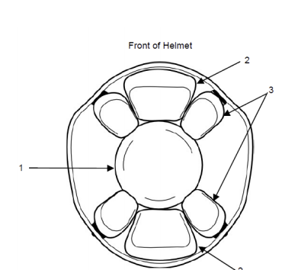
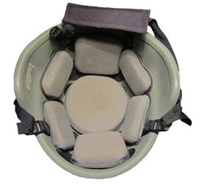
Helmets
Limited space on helmet due to volumetric constraints
EEG electrodes placed mainly near occipital lobe
Unit should fit within 70mm x 70mm x 5mm (W x L x H)
2cm thick pads
Rigid PCB placed in rear (position 4)
Margin of 1cm
Max height of component housing ~5mm
4

Slide 8
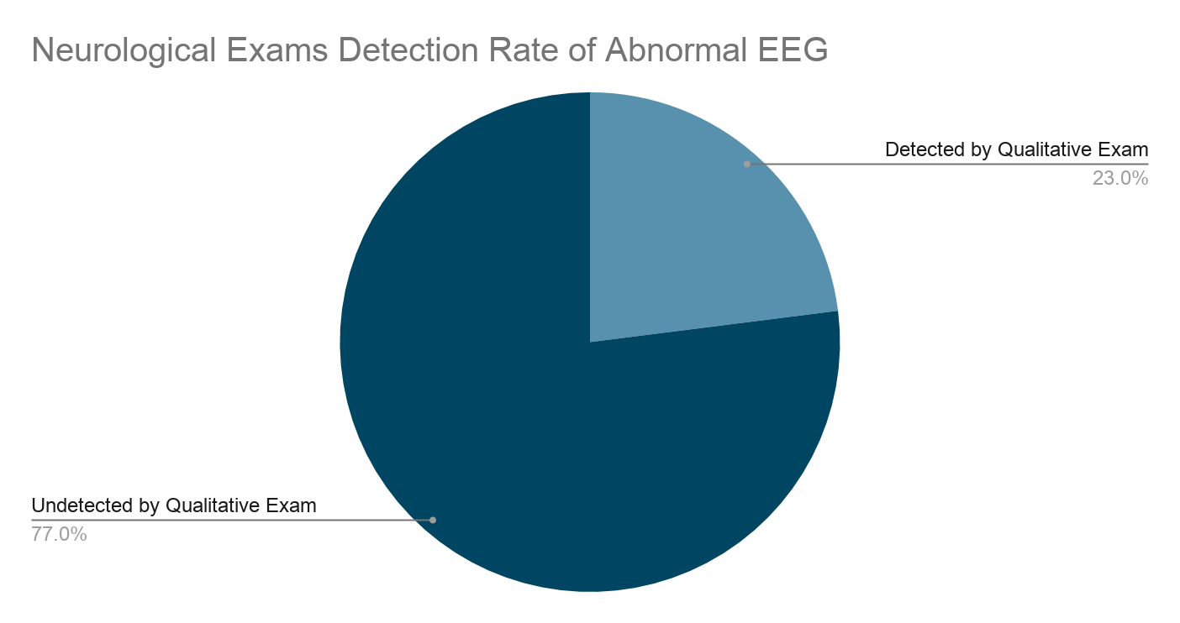
A Sensitive Tool for the Quantitative Screening of Head Injuries
Electroencephalogram (EEG) analysis compared to neurological exams^{[5]}
EEG analysis is shown to be more sensitive than qualitative neurological exams
[5] https://www.ncbi.nlm.nih.gov/pmc/articles/PMC5619208/
Notes:
[4] https://www.ncbi.nlm.nih.gov/pmc/articles/PMC5619208/

Slide 9
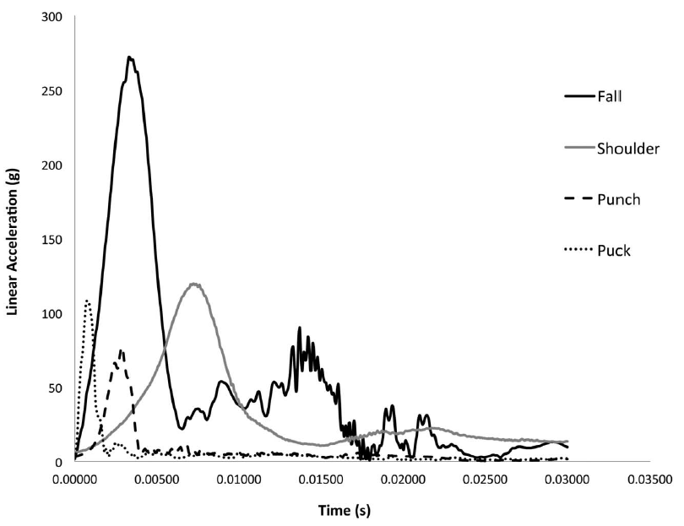
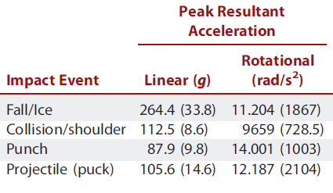
Linear acceleration-time curves

Slide 10
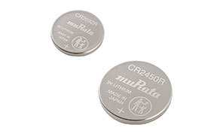
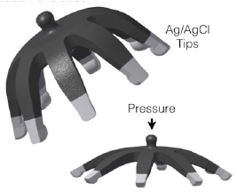
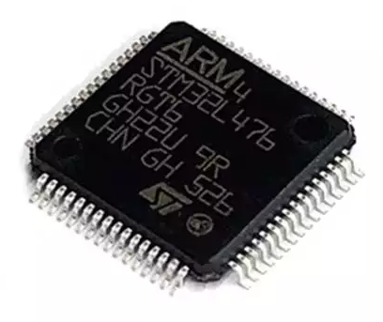
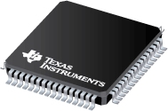
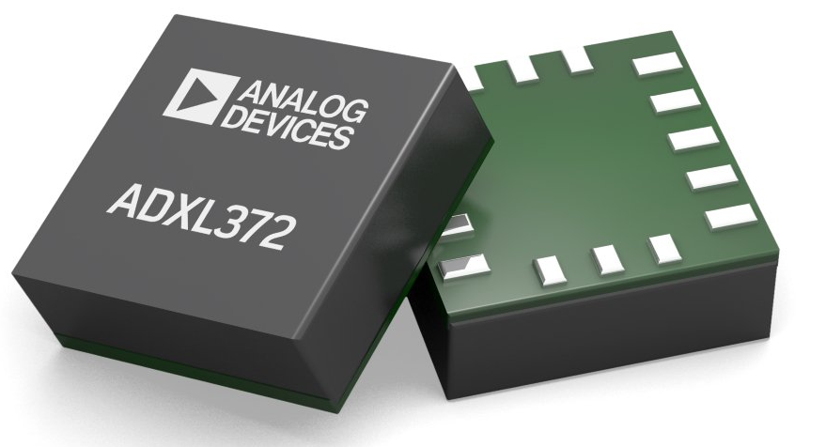
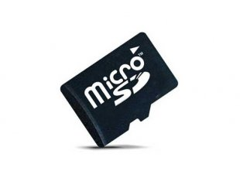
8-Channel System Overview
Analog Voltage ~5V
Digital Voltage ~3V
ADS1299 Biopotential Amplifier and ADC
STM32L4 Series Ultra-Low-Power ARM Cortex-M4 Microcontroller
ADXL372 High-Impact Ultra-Low-Power MEMs Accelerometer
Emphasis on high integration and low power
Mass Flash Memory for Big Data Analysis and External Export
Notes:
https://www.ti.com/lit/ds/symlink/ads1299.pdf?ts=1605462363116&ref_url=https%253A%252F%252Fwww.ti.com%252Fproduct%252FADS1299

Slide 11
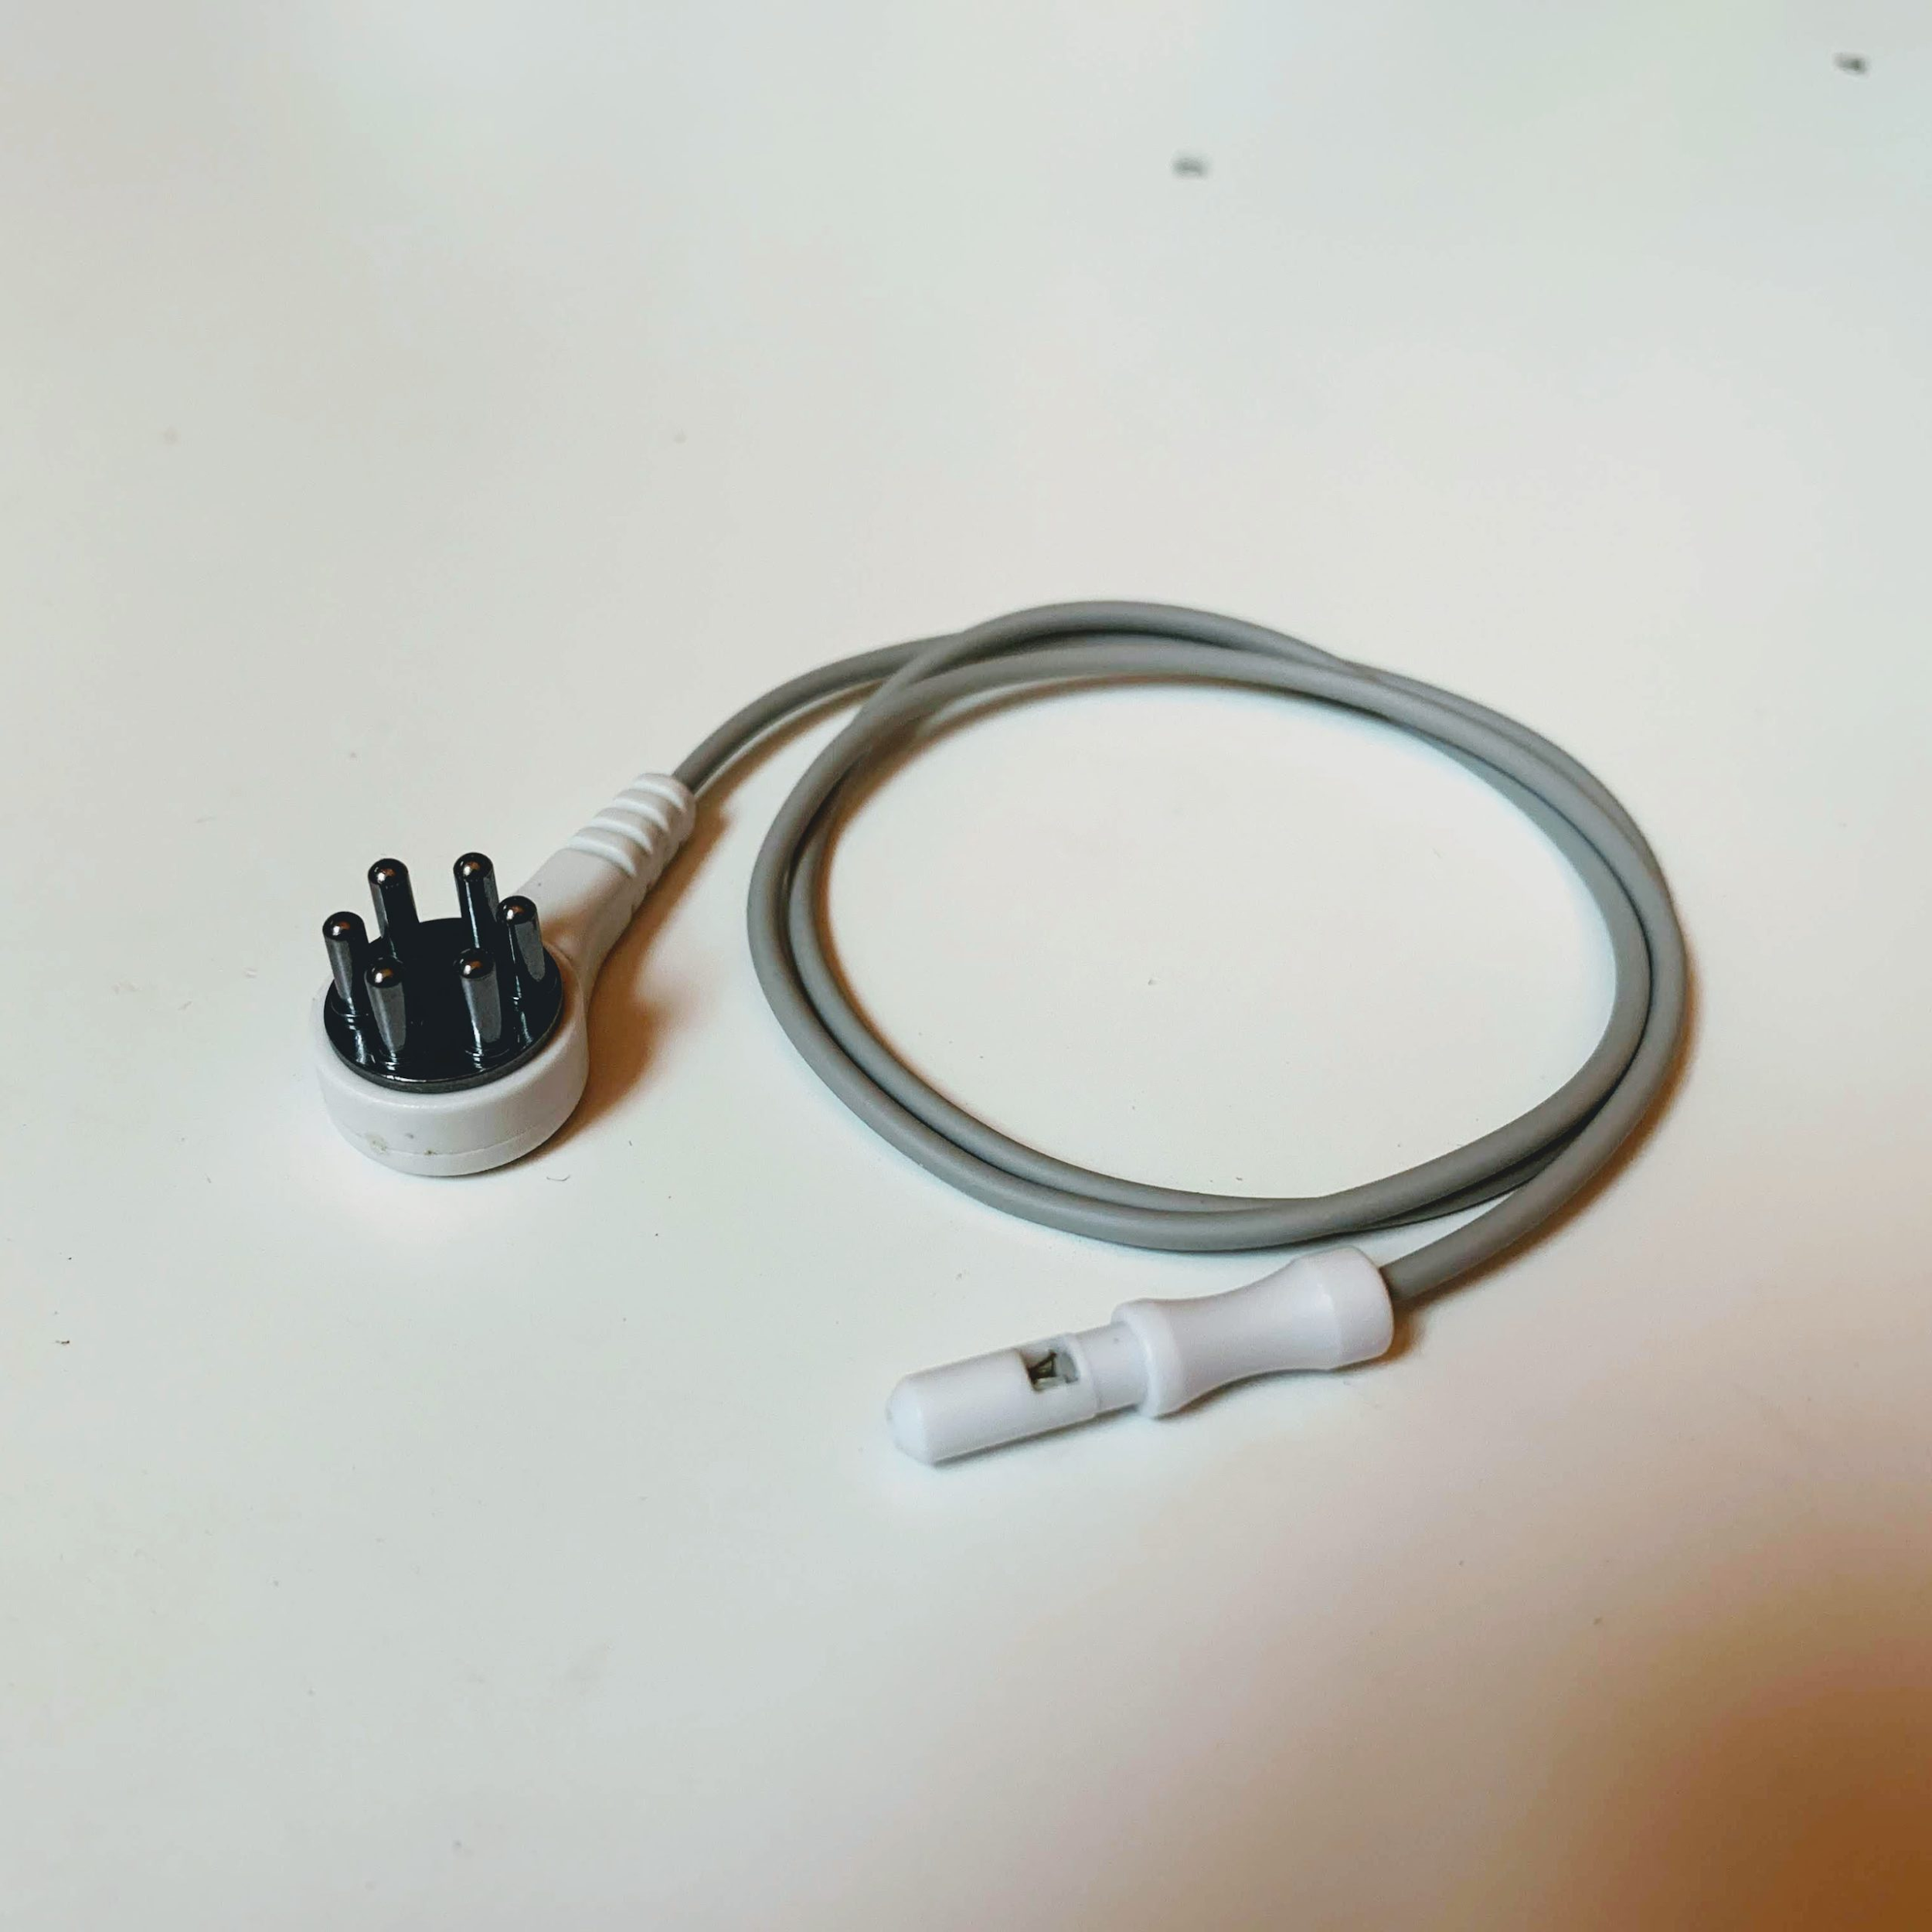
Electrodes
Hot-pluggable systems allows for flexibility in electrode selection
Most promising so far pictured below
What mechanical connector should we use?
Direct through-hole solder joint seems most reliable for shock & vibration
https://www.fri-fl-shop.com/product/reusable-5mm-ag-agcl-spike-snap-electrode-tde-212/

Slide 12
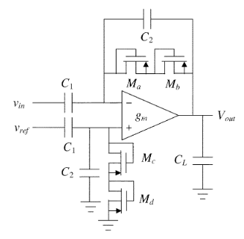
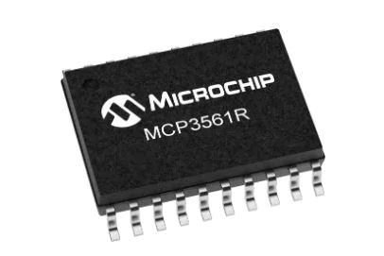
ADS1299 - Deciding Factors
Pros:
High Integration/Small Footprint
Simple Power Control
Flexible Body Potential Bias Schemes
High Resolution
Cons:
Cost
Bottom Line: While discretes were explored the ADS1299 offers the complete package, making up for its cost in reduced development time
versus
x8

Slide 13
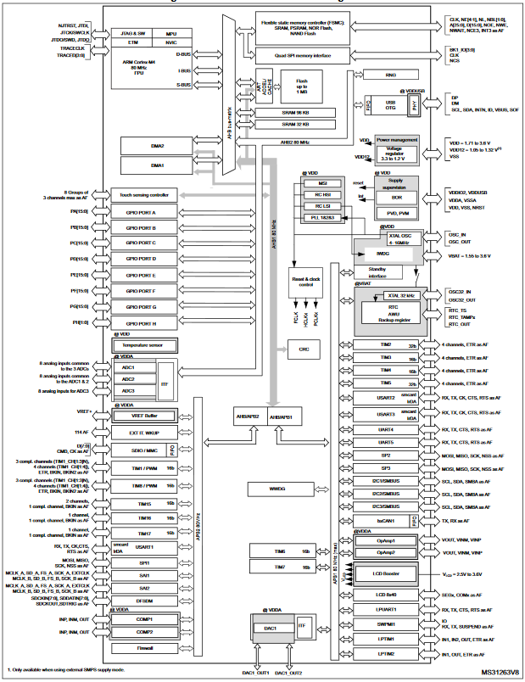
STM32L4 - Deciding Factors
Pros
Low Cost
Best-in-Class Ultra Low Power
Best-in-Class Development Environment
ST HAL, STM32CubeIDE, CMSIS
MBED Enabled
Cons
SDMMC 4 bit bus has silicon errata
Bottom Line: The STM32 microcontroller family is an industry staple. Tried and true, it just makes sense.

Slide 14
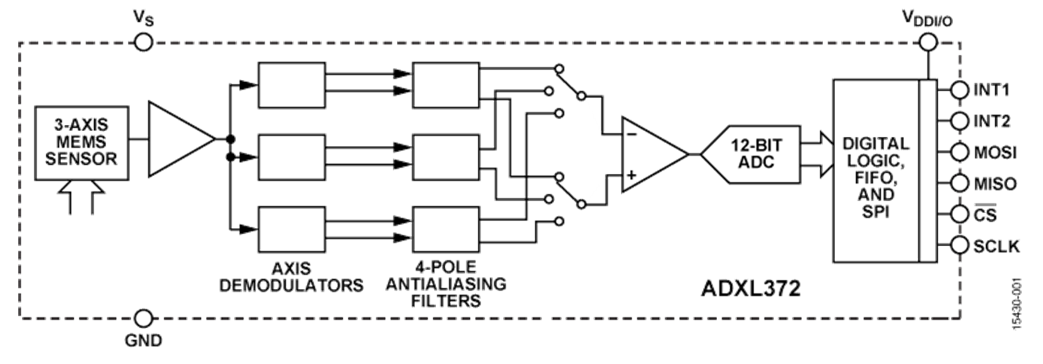
ADXL372 - Deciding Factors
Pros
Best-in-Class Ultra Low Power
High Impact Capable
Programmable Automated Interrupt Generation
Cons
Cost
Bottom Line: While the ADXL372 is expensive, it is unparalleled in capability for our application - where power, measurement range, and interrupt handling are key factors.

Slide 15
Mass Flash Storage - SDMMC
Pros:
Cheap
Easily interfaceable with ST HAL SDMMC
Allows for simple export to an external PC
Good for exploratory algorithm development
Cons:
Large footprint
Weak link in environmental resilience
Requires FatFs, a large middleware library

Slide 16
Power Consumption
Alternate between analysis and low-power sleep modes
Current Consumption
Power supplied by coin cells
Estimated battery life: 6-9 months
Op Mode | ADS1299 | STM32L4 | ADXL372 | Total
Analysis | 8.14mA | 2.6mA | 22uA | ~11mA
Sleep | 1.2uA | 22nA | 1.4uA | 2.622uA

Slide 17
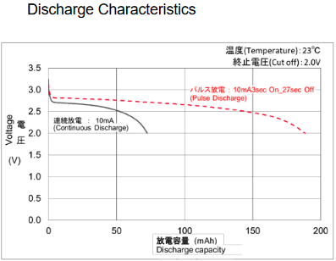
Power Delivery - Digital
Single Cell, Unregulated
IC | Operating Voltage
 | Min | Max
ADS1299 | 1.8 | 3.6
ADXL372 | 1.6 | 3.5
STM32L4 | 1.71 | 3.6

Slide 18
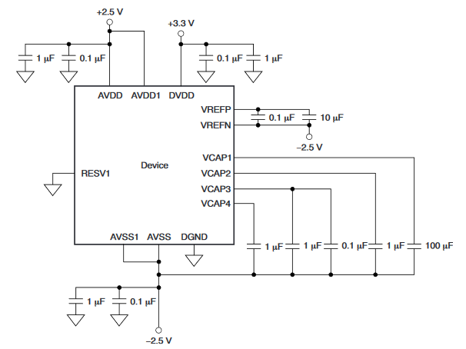
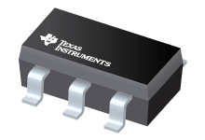
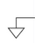
Power Deliver - Analog
Low-Noise LDO Regulated
Center-tapped AGND
Ganged EN Pins to uController GPIO for absolute no-current state in idle mode
ADS1299 SHTDWN pin and LDO EN pins will be brought up in a single GPIO port mask
+2.5V
-2.5V

Slide 19
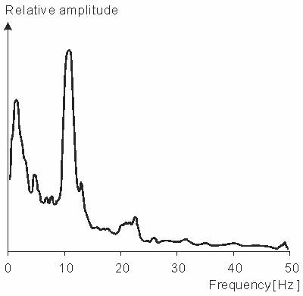
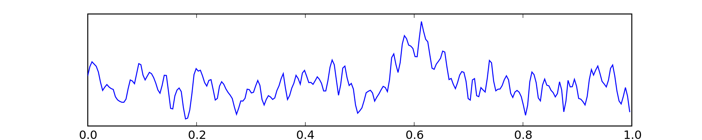
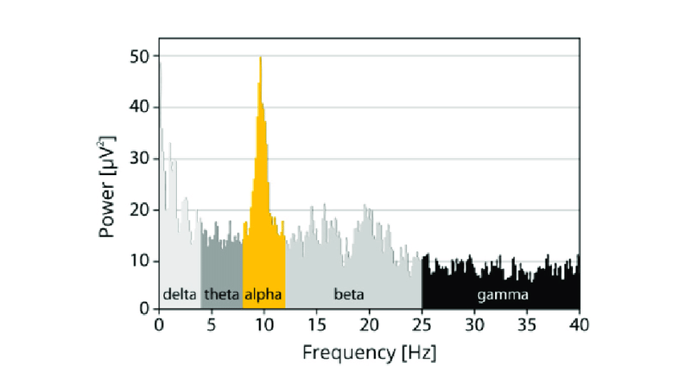
The Screening Signal Path
Frequency Analysis
Baseline Comparison and Notification of Abnormality
Electrodes
Analog Front-end and Digitization
Digital Signal Processing
Power Analysis
High Impact Sensor
Notes:
>make clearer
>be more specific with step by step (include energy and time needed for each step)

Slide 20
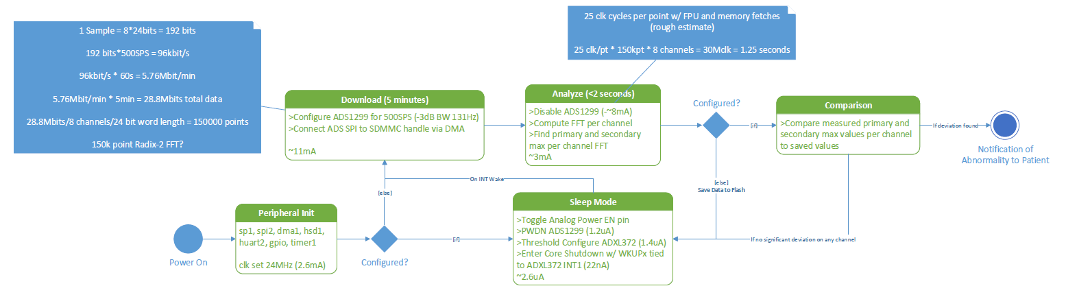
Firmware State Flow
Notes:
>sub-banding
>spectrograms
>spatio temporal output
>match filters sub one second
>become metrics in your classifiers
>look into EEG open source data to play with data in matlab
>get a meeting with the team

